Slide 1
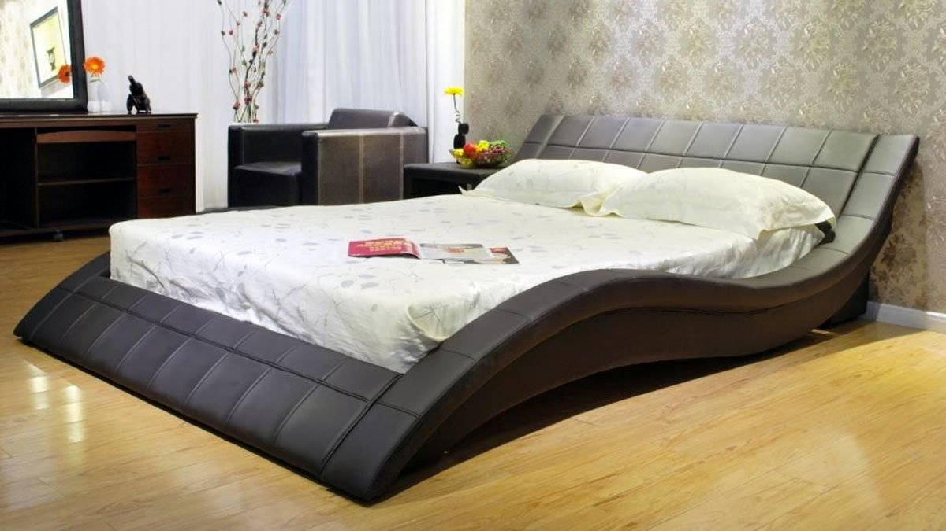

Welcome to Dreamland
-Ranjeet Yadav
This Photo by Unknown Author is licensed under CC BY-SA-NC

Slide 2
Project Introduction:-
My IPD project ,is a E-Commerce web application specially design for BEDDING ,where ,we provide everything related to bedding items like Mattresses ,Quilts ,pillows and much more.

Slide 3
PURPOSE OF OUR WEB APPLICATION:-
Purpose of my web application is to provide everything related to Bedding Items (like Quilts, mattresses , blankets ,pillows , coverlets and much more).
So that people can easily get anything related to the bedding on one platform .

Slide 4
HOW DREAM-LAMD DIFFERENT FROM OTHERS…
Every bedding related items easily getting on one platform.

Slide 5
NAME OF WEB APPLICATION AND LOGO:-
DREAM-LAND

Slide 6
TARGET AUDIENCE:-
This web application can be used by anyone who want to purchase easily everything related to bedding items.

Slide 7
RELEVANT TOOLS AND TECHNOLOGIES :-
The relevant tools and technologies used to develop the Dream-Land are HTML, CSS, bootstrap technology .
For backend , it is using PHP and Java-script .
If we talk about Tools , First preference is VS code and some online platform.

Slide 8

This Photo by Unknown Author is licensed under CC BY-SA

